Slide 1
REPORTING AND ALERTING CUTOFF ANALYSIS

Slide 2
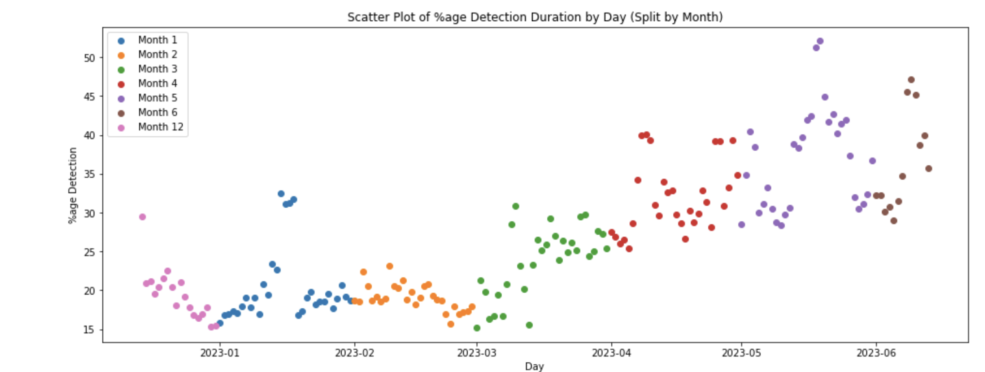
Determining the normal time period
11 Apr to 14 May

Slide 3
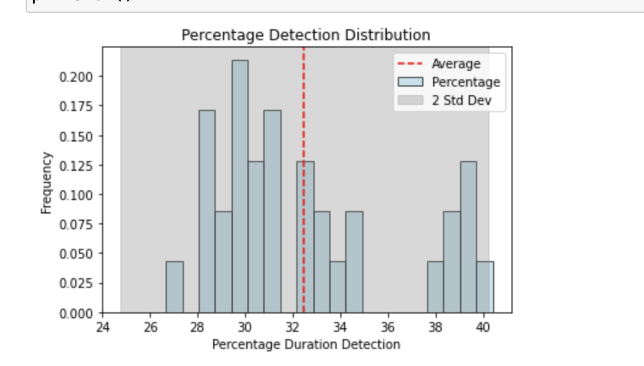
Probability Density & distribution of daily data
THE DISTRIBUTION IS NOT NORMAL SO WE CANNOT USE THE Z SCORE METHOD WHICH IS BASED ON HOW MANY STANDARD DEVIATIONS A POINT IS AWAY FROM THE MEAN TO IDENTIFY ANAMOLIES

Slide 4
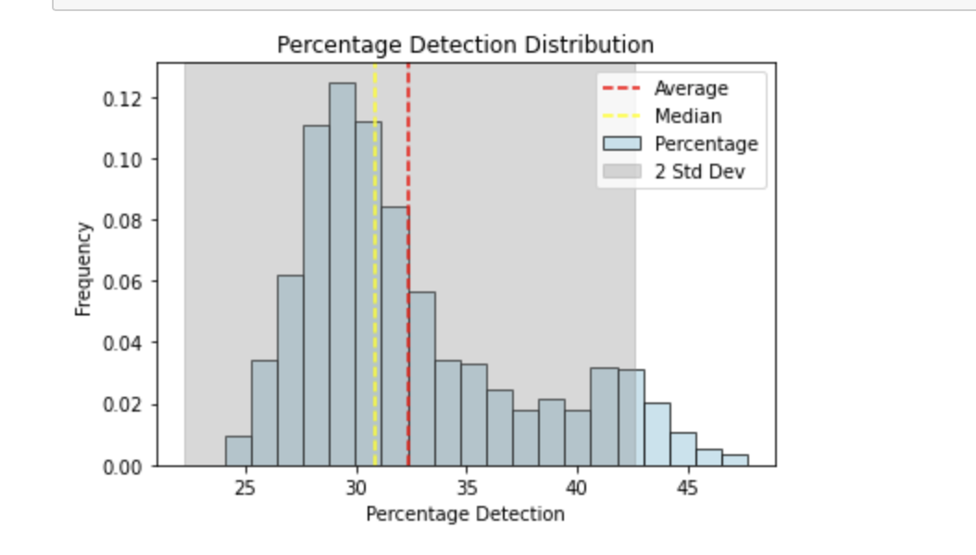
Probability Density & distribution of hourly data
THE DISTRIBUTION LOOKS BETTER BECAUSE WE HAVE MORE DATA BUT IT IS STILL RIGHT SKEWED AND NOT NORMAL

Slide 5
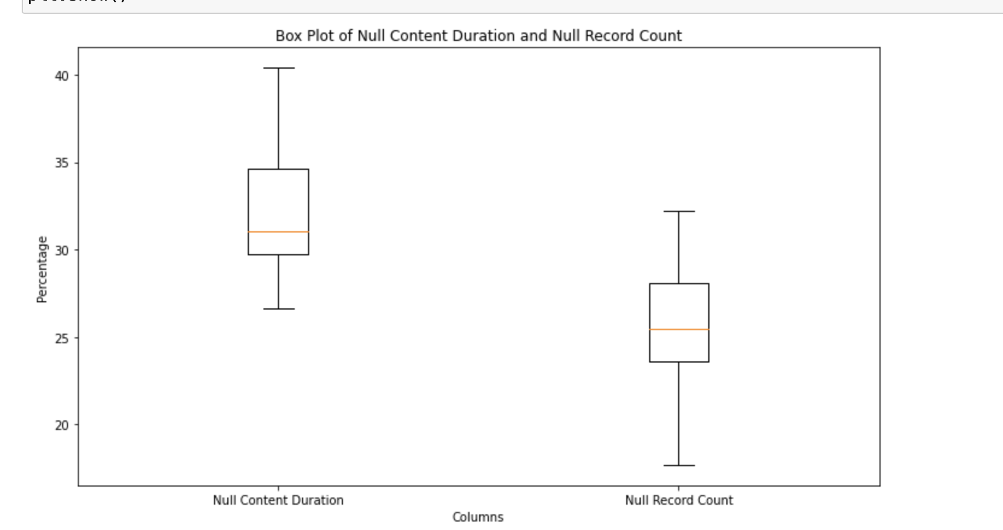
ALTERNATIVE 1: USING IQR METHOD TO IDENTIFY OUTLIERS
Calculate the first quartile (Q1) and third quartile (Q3) of the dataset
Define the lower and upper bounds for identifying outliers. Typically, data points that are located below Q1 - 1.5 * IQR or above Q3 + 1.5 * IQR are considered outliers
Flag the rows where the values fall outside the lower and upper bounds as outliers.

Slide 6
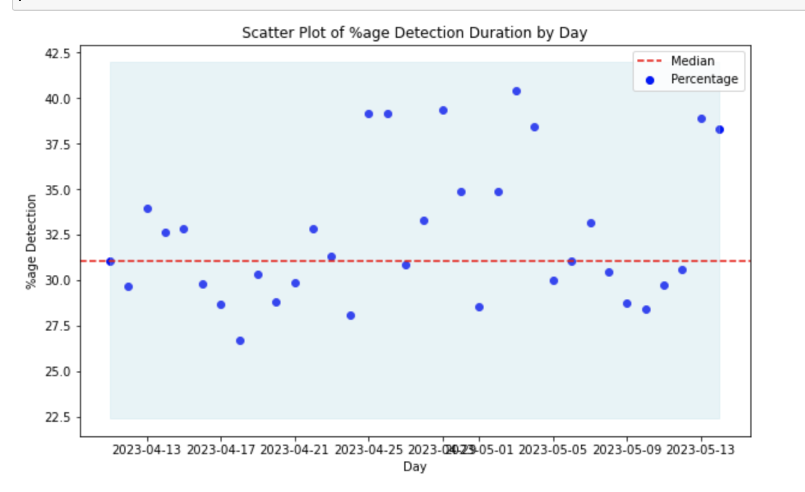
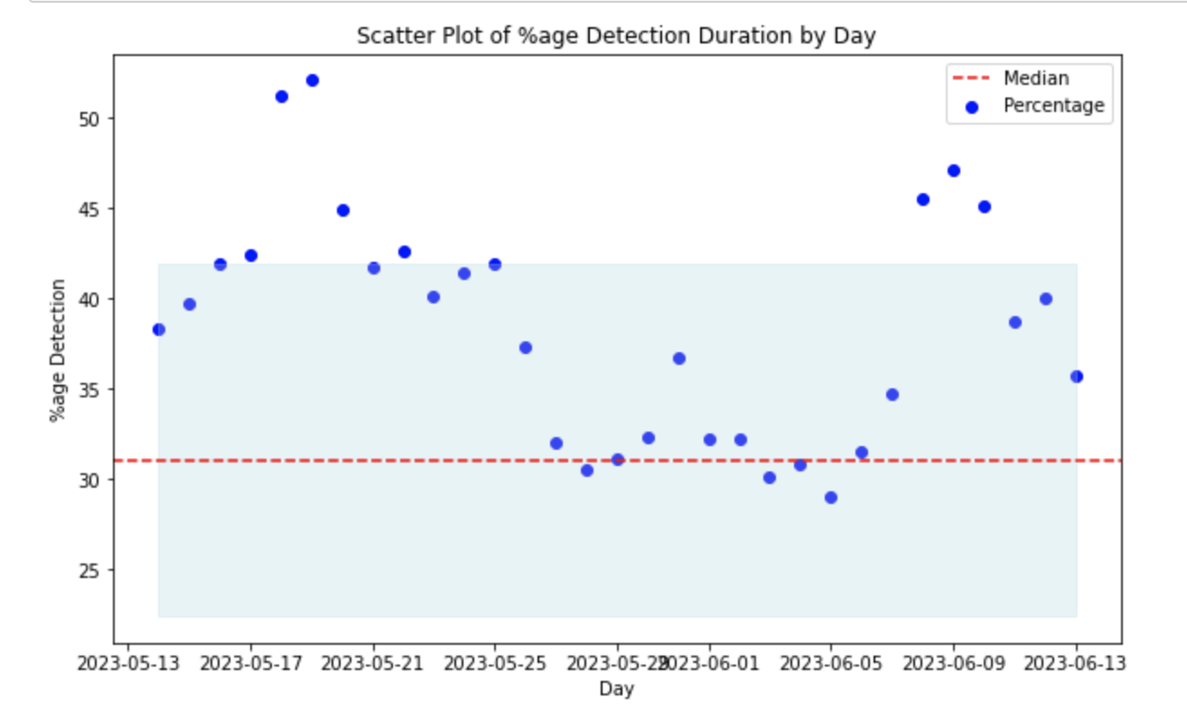
RESULTS
ON OLD DATA (April 9 to May 13): No Outliers
ON NEW DATA (After May 13): Above 42.5% are outliers

Slide 7
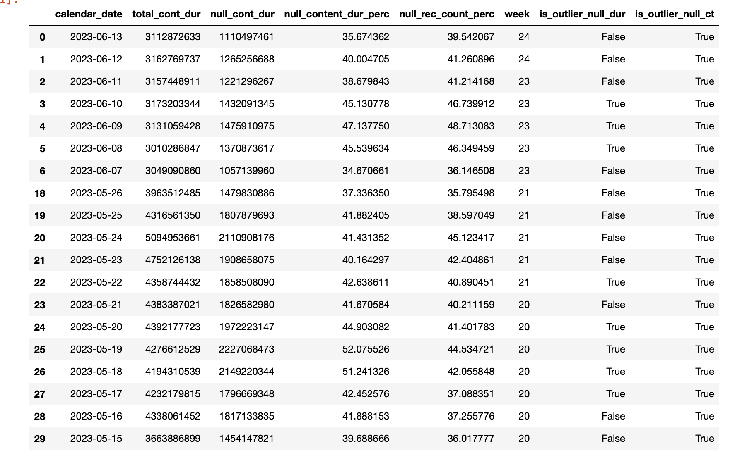

Slide 8
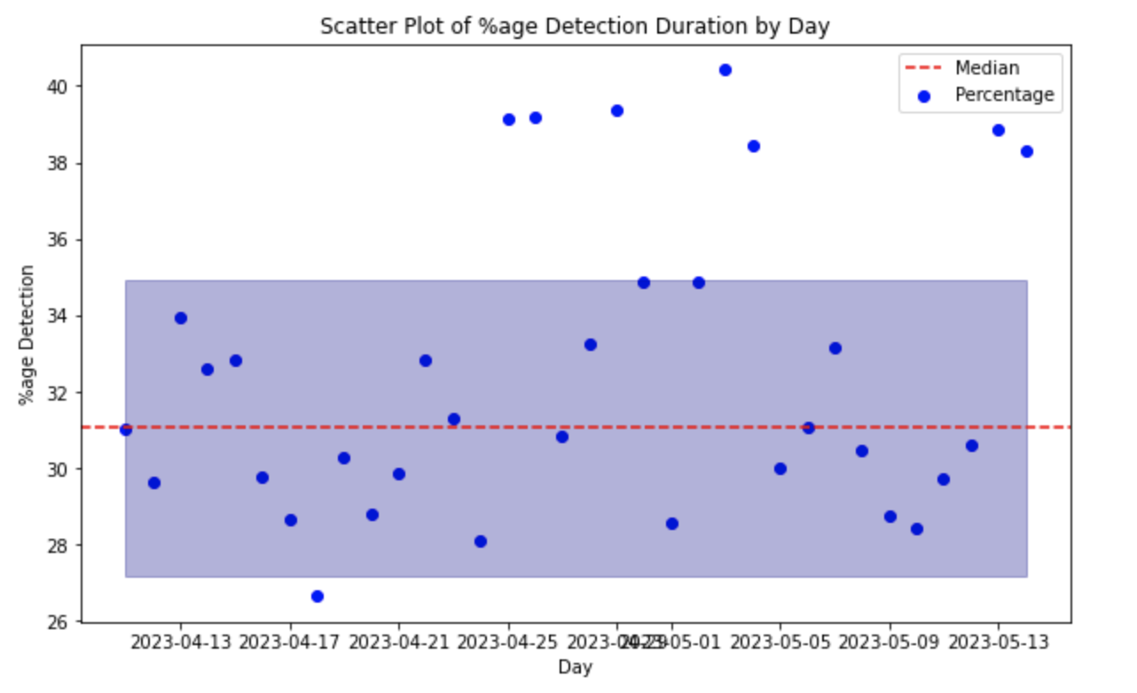
ALTERNATIVE 2:USING MODIFIED Z SCORE TO IDENTIFY OUTLIERS
Compute the median and median absolute deviation of the column. MAD is calculated as the median of the absolute differences between each data point and the median
Calculate the modified z-score for each data point using the formula: modified z-score = 0.6745 * (x - median) / MAD
Set a threshold value for the modified z-score above which data points are considered outliers. Identify the outliers by filtering the data points with a modified z-score above the threshold.

Slide 9
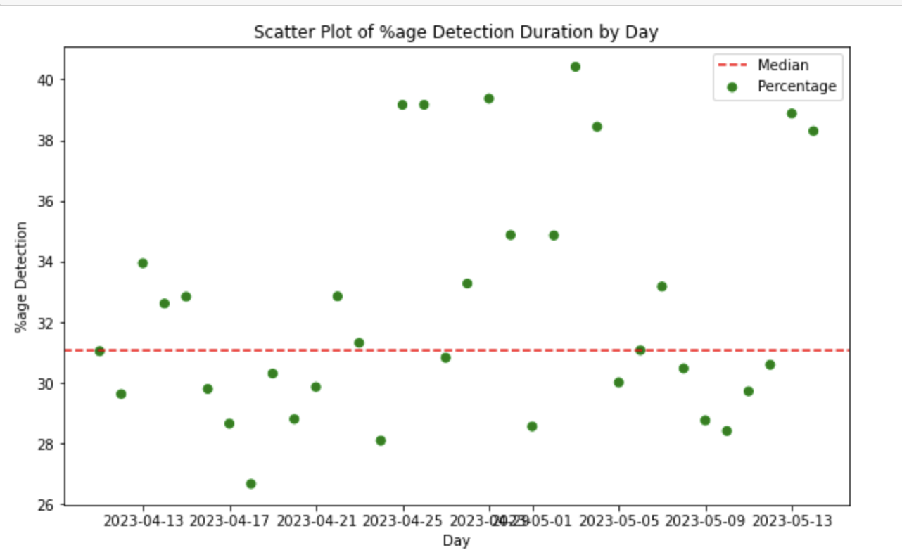
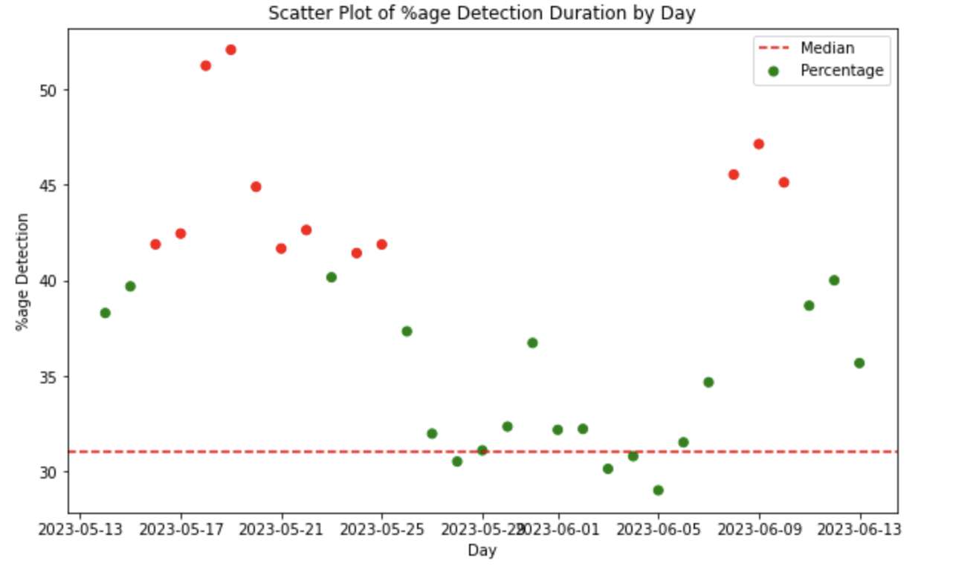
RESULTS
ON OLD DATA (April9 to May13): No Outliers
ON NEW DATA (After May 13): Above ~42% are outliers

